Slide 1

Welcome to the labs!
Welcome to the Labs
Hashing Functions

Slide 2
Who are the tutors?

Slide 3
Who are you?

Slide 4








People Bingo
Rules: 1) Read each square. 2) Find a new friend who can complete any of the squares. 3) One friend can fill in one square only. 4) The first person to fill in every square wins!
Can fluently speak more than one language 🗣 | Has been to GPN before 💚 | Has visited another country ✈️ | Can play chess ♟ | Has more than 1 pet 🐶
Favourite food is Pizza 🍕 | Knows what a Kumquat is ❓ | Has made their own pasta 🍝 | Has eaten Dragon fruit 🐲 | Was born in another country 🌎
Knows how to Juggle 🤹‍♀️ | Likes to play Tetris 🎮 | Is an only child 👨‍👩‍👧 | Likes to paint 🎨 | Knows a magic trick 🪄
Plays an instrument 🎶 | Can ride a skateboard 🛹 | Likes to read 📖 | Has the same favourite colour as you 🌈 | Has the same eye colour as you 👀
Has a part time or casual job 💰 | Is in the same school year as you 🚌 | Knows the second verse of the national anthem 🇦🇺 | Has created their own coding project 💻 | Plays sport on the weekend ⚽️

Slide 5
Tell us you’re here!
Click on the
End of Day Survey
and fill it in now!

Slide 6
Today’s project!
Password Cracker!

Slide 7

Using the workbook!
The workbooks will help you put your project together!
Each Part of the workbook is made of tasks!
Tasks - The parts of your project
Follow the tasks in order to make the project!
Task 6.2: Add a blah to your code!
This has instructions on how to do a part of the project Start by doing this part Then you can do this part
Hints - Helpers for your tasks!
Stuck on a task, we might have given you a hint to help you figure it out! The hints have unrelated examples, or tips. Don’t copy and paste in the code, you’ll end up with something CRAZY!
Task 6.1: Make the thing do blah!
Make your project do blah ….
Hint
A clue, an example or some extra information to help you figure out the answer.
print('This example is not part of the project’)

Slide 8

Using the workbook!
The workbooks will help you put your project together!
Check off before you move on from a Part! Do some bonuses while you wait!
Checklist - Am I done yet?
Make sure you can tick off every box in this section before you go to the next Part.
CHECKPOINT
If you can tick all of these off you’re ready to move the next part! ☐ Your program does blah ☐ Your program does blob
Lecture Markers
This tells you you’ll find out how to do things for this section during the names lecture.
Bonus Activities
Stuck waiting at a lecture marker?
Try a purple bonus. They add extra functionality to your project along the way.
★ BONUS 4.3: Do some extra!
Something to try if you have spare time before the next lecture!

Slide 9


Rainbow Tables

Slide 10
What is a Rainbow Table?
How can we figure out a password?
Remember that we can not work backwards
from a hash because they are irreversible
But every unique string gives a unique hash
(e.g. if you hash ‘apple’ it will always give the same hash)
What if we work forwards instead?
We could guess the password!

Slide 11
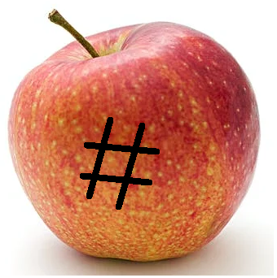
What is a Rainbow Table?
Plaintext password = 'apple'
hashed password = b’\x1f8p\xbe'OlI\xb3\xe3\x1a\x0cg(\x95\x7f’

Slide 12
What is a Rainbow Table?
We can make a lot of guesses!
A rainbow table is a collection of a lot of possible passwords
and their hashes
It makes sense to use the most common passwords in the table
This will help you break into the most accounts!
Rainbow tables show you “the entire spectrum of possibilities”.
https://stackoverflow.com/questions/5051608/why-is-it-called-rainbow-table

Slide 13

Let's Crack a password
We've discovered a list of leaked password hashes.
Let's try and crack one of them with a rainbow table!
What's the plaintext of
b'\xe8\x07\xf1\xfc\xf8-\x13/\x9b\xb0\x18\xcag8\xa1\x9f'

Slide 14
Our rainbow table
Plaintext | Hashes
password | b'_M\xcc;Z\xa7e\xd6\x1d\x83'\xde\xb8\x82\xcf\x99'
password123 | b'H,\x81\x1d\xa5\xd5\xb4\xbcmI\x7f\xfa\x98I\x1e8'
p@ssw0rd | b'\x0f5\x97@\xbd\x1c\xda\x99O\x8bU3\x0c\x86\xd8E'
1234567890 | b'\xe8\x07\xf1\xfc\xf8-\x13/\x9b\xb0\x18\xcag8\xa1\x9f'
qwerty | b'\xd8W\x8e\xdf\x84X\xce\x06\xfb\xc5\xbbv\xa5\x8c\\\xa4'
qwerty123 | b'?\xc0\xa7\xac\xf0\x87\xf5I\xac+&k\xaf\x94\xb8\xb1'
Notes:
Code to get hashvalues: import hashlib
plaintext="qwerty" plaintext_encoded=plaintext.encode() print(hashlib.md5(plaintext_encoded).digest())

Slide 15
Let's Crack a password
Hash to crack: b'\xe8\x07\xf1\xfc\xf8-\x13/\x9b\xb0\x18\xcag8\xa1\x9f'
Do these match?
Plaintext | Hashes
password | b'_M\xcc;Z\xa7e\xd6\x1d\x83'\xde\xb8\x82\xcf\x99'
password123 | b'H,\x81\x1d\xa5\xd5\xb4\xbcmI\x7f\xfa\x98I\x1e8'
p@ssw0rd | b'\x0f5\x97@\xbd\x1c\xda\x99O\x8bU3\x0c\x86\xd8E'
1234567890 | b'\xe8\x07\xf1\xfc\xf8-\x13/\x9b\xb0\x18\xcag8\xa1\x9f'
qwerty | b'\xd8W\x8e\xdf\x84X\xce\x06\xfb\xc5\xbbv\xa5\x8c\\\xa4'
qwerty123 | b'?\xc0\xa7\xac\xf0\x87\xf5I\xac+&k\xaf\x94\xb8\xb1'

Slide 16
Let's Crack a password
Hash to crack: b'\xe8\x07\xf1\xfc\xf8-\x13/\x9b\xb0\x18\xcag8\xa1\x9f'
Do these match? No, let's try the next one
Plaintext | Hashes
password | b'_M\xcc;Z\xa7e\xd6\x1d\x83'\xde\xb8\x82\xcf\x99'
password123 | b'H,\x81\x1d\xa5\xd5\xb4\xbcmI\x7f\xfa\x98I\x1e8'
p@ssw0rd | b'\x0f5\x97@\xbd\x1c\xda\x99O\x8bU3\x0c\x86\xd8E'
1234567890 | b'\xe8\x07\xf1\xfc\xf8-\x13/\x9b\xb0\x18\xcag8\xa1\x9f'
qwerty | b'\xd8W\x8e\xdf\x84X\xce\x06\xfb\xc5\xbbv\xa5\x8c\\\xa4'
qwerty123 | b'?\xc0\xa7\xac\xf0\x87\xf5I\xac+&k\xaf\x94\xb8\xb1'

Slide 17
Let's Crack a password
Hash to crack: b'\xe8\x07\xf1\xfc\xf8-\x13/\x9b\xb0\x18\xcag8\xa1\x9f'
Do these match?
Plaintext | Hashes
password | b'_M\xcc;Z\xa7e\xd6\x1d\x83'\xde\xb8\x82\xcf\x99'
password123 | b'H,\x81\x1d\xa5\xd5\xb4\xbcmI\x7f\xfa\x98I\x1e8'
p@ssw0rd | b'\x0f5\x97@\xbd\x1c\xda\x99O\x8bU3\x0c\x86\xd8E'
1234567890 | b'\xe8\x07\xf1\xfc\xf8-\x13/\x9b\xb0\x18\xcag8\xa1\x9f'
qwerty | b'\xd8W\x8e\xdf\x84X\xce\x06\xfb\xc5\xbbv\xa5\x8c\\\xa4'
qwerty123 | b'?\xc0\xa7\xac\xf0\x87\xf5I\xac+&k\xaf\x94\xb8\xb1'

Slide 18
Let's Crack a password
Hash to crack: b'\xe8\x07\xf1\xfc\xf8-\x13/\x9b\xb0\x18\xcag8\xa1\x9f'
Do these match? No, let's try the next one
Plaintext | Hashes
password | b'_M\xcc;Z\xa7e\xd6\x1d\x83'\xde\xb8\x82\xcf\x99'
password123 | b'H,\x81\x1d\xa5\xd5\xb4\xbcmI\x7f\xfa\x98I\x1e8'
p@ssw0rd | b'\x0f5\x97@\xbd\x1c\xda\x99O\x8bU3\x0c\x86\xd8E'
1234567890 | b'\xe8\x07\xf1\xfc\xf8-\x13/\x9b\xb0\x18\xcag8\xa1\x9f'
qwerty | b'\xd8W\x8e\xdf\x84X\xce\x06\xfb\xc5\xbbv\xa5\x8c\\\xa4'
qwerty123 | b'?\xc0\xa7\xac\xf0\x87\xf5I\xac+&k\xaf\x94\xb8\xb1'

Slide 19
Let's Crack a password
Hash to crack: b'\xe8\x07\xf1\xfc\xf8-\x13/\x9b\xb0\x18\xcag8\xa1\x9f'
Do these match?
Plaintext | Hashes
password | b'_M\xcc;Z\xa7e\xd6\x1d\x83'\xde\xb8\x82\xcf\x99'
password123 | b'H,\x81\x1d\xa5\xd5\xb4\xbcmI\x7f\xfa\x98I\x1e8'
p@ssw0rd | b'\x0f5\x97@\xbd\x1c\xda\x99O\x8bU3\x0c\x86\xd8E'
1234567890 | b'\xe8\x07\xf1\xfc\xf8-\x13/\x9b\xb0\x18\xcag8\xa1\x9f'
qwerty | b'\xd8W\x8e\xdf\x84X\xce\x06\xfb\xc5\xbbv\xa5\x8c\\\xa4'
qwerty123 | b'?\xc0\xa7\xac\xf0\x87\xf5I\xac+&k\xaf\x94\xb8\xb1'

Slide 20
Let's Crack a password
Hash to crack: b'\xe8\x07\xf1\xfc\xf8-\x13/\x9b\xb0\x18\xcag8\xa1\x9f'
Do these match? No, let's try the next one.
Plaintext | Hashes
password | b'_M\xcc;Z\xa7e\xd6\x1d\x83'\xde\xb8\x82\xcf\x99'
password123 | b'H,\x81\x1d\xa5\xd5\xb4\xbcmI\x7f\xfa\x98I\x1e8'
p@ssw0rd | b'\x0f5\x97@\xbd\x1c\xda\x99O\x8bU3\x0c\x86\xd8E'
1234567890 | b'\xe8\x07\xf1\xfc\xf8-\x13/\x9b\xb0\x18\xcag8\xa1\x9f'
qwerty | b'\xd8W\x8e\xdf\x84X\xce\x06\xfb\xc5\xbbv\xa5\x8c\\\xa4'
qwerty123 | b'?\xc0\xa7\xac\xf0\x87\xf5I\xac+&k\xaf\x94\xb8\xb1'

Slide 21
Let's Crack a password
Hash to crack: b'\xe8\x07\xf1\xfc\xf8-\x13/\x9b\xb0\x18\xcag8\xa1\x9f'
Do these match?
Plaintext | Hashes
password | b'_M\xcc;Z\xa7e\xd6\x1d\x83'\xde\xb8\x82\xcf\x99'
password123 | b'H,\x81\x1d\xa5\xd5\xb4\xbcmI\x7f\xfa\x98I\x1e8'
p@ssw0rd | b'\x0f5\x97@\xbd\x1c\xda\x99O\x8bU3\x0c\x86\xd8E'
1234567890 | b'\xe8\x07\xf1\xfc\xf8-\x13/\x9b\xb0\x18\xcag8\xa1\x9f'
qwerty | b'\xd8W\x8e\xdf\x84X\xce\x06\xfb\xc5\xbbv\xa5\x8c\\\xa4'
qwerty123 | b'?\xc0\xa7\xac\xf0\x87\xf5I\xac+&k\xaf\x94\xb8\xb1'

Slide 22
Let's Crack a password
Hash to crack: b'\xe8\x07\xf1\xfc\xf8-\x13/\x9b\xb0\x18\xcag8\xa1\x9f'
Do these match? Yes! Now we can get the plaintext.
Plaintext | Hashes
password | b'_M\xcc;Z\xa7e\xd6\x1d\x83'\xde\xb8\x82\xcf\x99'
password123 | b'H,\x81\x1d\xa5\xd5\xb4\xbcmI\x7f\xfa\x98I\x1e8'
p@ssw0rd | b'\x0f5\x97@\xbd\x1c\xda\x99O\x8bU3\x0c\x86\xd8E'
1234567890 | b'\xe8\x07\xf1\xfc\xf8-\x13/\x9b\xb0\x18\xcag8\xa1\x9f'
qwerty | b'\xd8W\x8e\xdf\x84X\xce\x06\xfb\xc5\xbbv\xa5\x8c\\\xa4'
qwerty123 | b'?\xc0\xa7\xac\xf0\x87\xf5I\xac+&k\xaf\x94\xb8\xb1'

Slide 23
Let's Crack a password
Hash to crack: b'\xe8\x07\xf1\xfc\xf8-\x13/\x9b\xb0\x18\xcag8\xa1\x9f'
Do these match? Yes! Now we can get the plaintext. It's 1234567890
Plaintext | Hashes
password | b'_M\xcc;Z\xa7e\xd6\x1d\x83'\xde\xb8\x82\xcf\x99'
password123 | b'H,\x81\x1d\xa5\xd5\xb4\xbcmI\x7f\xfa\x98I\x1e8'
p@ssw0rd | b'\x0f5\x97@\xbd\x1c\xda\x99O\x8bU3\x0c\x86\xd8E'
1234567890 | b'\xe8\x07\xf1\xfc\xf8-\x13/\x9b\xb0\x18\xcag8\xa1\x9f'
qwerty | b'\xd8W\x8e\xdf\x84X\xce\x06\xfb\xc5\xbbv\xa5\x8c\\\xa4'
qwerty123 | b'?\xc0\xa7\xac\xf0\x87\xf5I\xac+&k\xaf\x94\xb8\xb1'

Slide 24
Choosing passwords
Storing hashes for every single possible password
would use up a lot of space.
So hackers usually only create rainbow tables
with the most common passwords……
Which is why you shouldn't use common passwords. That would make your account very easy to get into.

Slide 25
Data Breaches
Stealing passwords is something criminals are always trying to do. These companies have had their users' passwords exposed online recently. How many of them do you use?
Facebook (2019) 533 million users
Linkedin (2021) 700 million users
Twitter (2018) 330 million users
Uber (2016) 57 million users
Twitch (2021) 7 million
Zoom (2020) 500,000
src: https://www.upguard.com/blog/biggest-data-breaches

Slide 26
Data Breaches
Stealing passwords is something criminals are always trying to do. These companies have had their users' passwords exposed online recently. How many of them do you use?
Facebook (2019) 533 million users
Linkedin (2021) 700 million users
Twitter (2018) 330 million users
Uber (2016) 57 million users
Twitch (2021) 7 million
Zoom (2020) 500,000
Imagine how easy it would be to hack into your accounts if they all used the same password!
src: https://www.upguard.com/blog/biggest-data-breaches

Slide 27
Project Time!
Now that you've learnt all about rainbow tables!
Let’s put what we learnt into our project
Try to do Part 0
of workbook 2!
The tutors will be around to help!

Slide 28
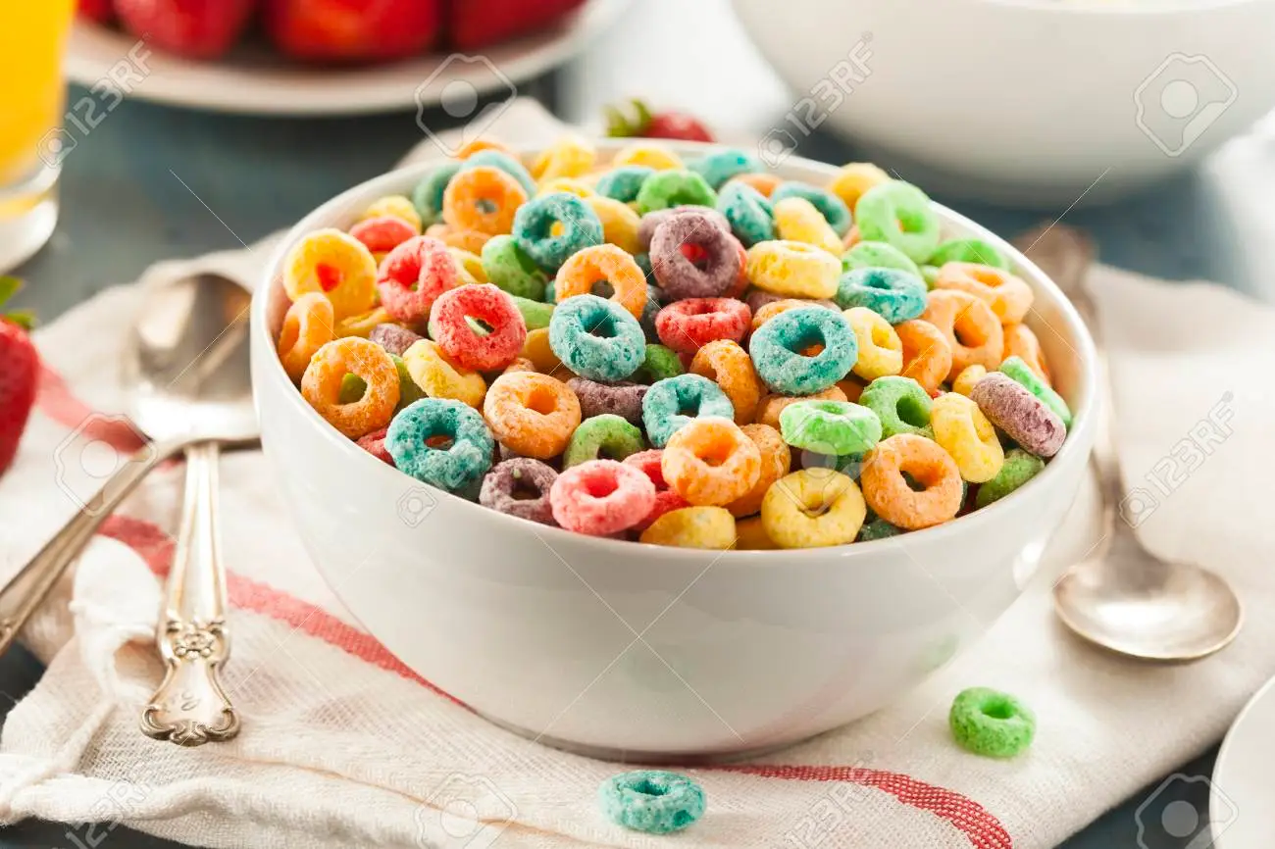
Files and For Loops

Slide 29

Opening files!
We can store information inside files.
Then we can use these files in our code!
To get access to the stuff inside a file in python, we need to open it!
(That doesn’t mean clicking on the little icon)
for line in open(“test.txt”):
print(line)
Important: The file needs to be in the same place as your code

Slide 30
Opening Files
Let’s break that code down a bit!
for line in open(“test.txt”):
print(line)
This bit is called a for loop, we’ll learn about that in the next few slides!

Slide 31
Opening Files
Let’s break that code down a bit!
for line in open(“test.txt”):
print(line)
This bit is called a for loop, we’ll learn about that in the next few slides!
Over here is where we tell our code that we want to open the file!

Slide 32
Opening Files
Let’s break that code down a bit!
for line in open(“test.txt”):
print(line)
Here is where we put the name of the file we want to open
This bit is called a for loop, we’ll learn about that in the next few slides!
Over here is where we tell our code that we want to open the file!

Slide 33
Opening Files
Let’s break that code down a bit!
for line in open(“test.txt”):
print(line)
Here is where we put the name of the file we want to open
This bit is called a for loop, we’ll learn about that in the next few slides!
Over here is where we tell our code that we want to open the file!
Finally, this is what we want to do with each line of the file.

Slide 34

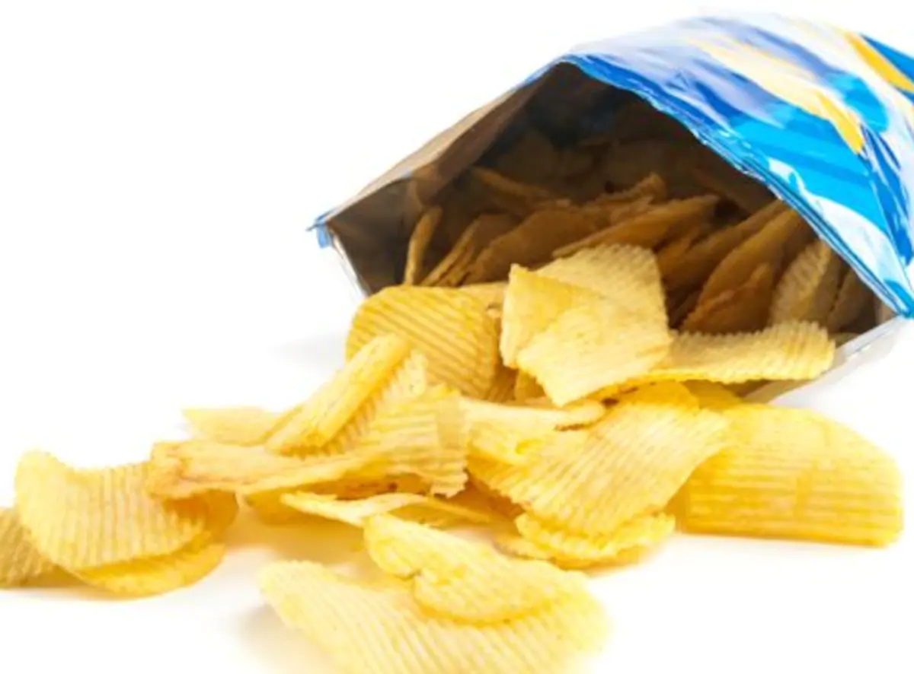
For Loops
For loops allow you to do something for each item in a group of things
There are many real world examples, like:
For each page in this book:
Read
For each chip in this bag of chips:
Eat

Slide 35
Reading line by line
My cat wrote this Haiku for me and I want my program to print out each line:
Wanna go outside.
Oh NO! Help I got outside!
Let me back inside!

Slide 36
Reading line by line
My cat wrote this Haiku for me and I want my program to print out each line:
Wanna go outside.
Oh NO! Help I got outside!
Let me back inside!
We can use for loops to read individual lines of files

Slide 37
Reading line by line
My cat wrote this Haiku for me and I want my program to print out each line:
Wanna go outside.
Oh NO! Help I got outside!
Let me back inside!
We can use for loops to read individual lines of files
for line in open('haiku.txt'):
print(line)
What do you think this will print?

Slide 38
Reading line by line
My cat wrote this Haiku for me and I want my program to print out each line:
Wanna go outside.
Oh NO! Help I got outside!
Let me back inside!
We can use for loops to read individual lines of files
for line in open('haiku.txt'):
print(line)
Wanna go outside. Oh NO! Help! I got outside! Let me back inside!
But there are extra lines?

Slide 39

Chomping off the newline
The newline character is represented by '\n':
print('Hello\nWorld') Hello World
We can remove it from the lines we read with .strip()
x = 'abc\n'
x.strip()
'abc'
Notes:
The newline character is kept on the end of the lines by default when you read in a file.
You can cut it off with the dot strip method - probably the safest way - or you can slice the string to take off the last character.

Slide 40

Reading and stripping!
for line in open('haiku.txt'):
line = line.strip()
print(line)
Wanna go outside. Oh NO! Help! I got outside! Let me back inside!
No extra lines!
Notes:
Running through this again, you can see there's only one newline this time - the newline coming from the print statement.

Slide 41


A missing file causes an error
This is what happens if you try to open a file that doesn’t exist:
open('missing.txt')
Traceback (most recent call last):
File "<stdin>", line 1, in <module>
IOError: [Errno 2] No such file or directory: 'missing.txt'
Notes:
You'll get an IOError if you try to open a file that apparently doesn't exist.
That might happen if you're trying to access a file that's not in the current directory.

Slide 42
Project Time!
Now you know how to use for loops and files!
Try to do Part 1
of workbook 2!!
The tutors will be around to help!

Slide 43

Dictionaries

Slide 44
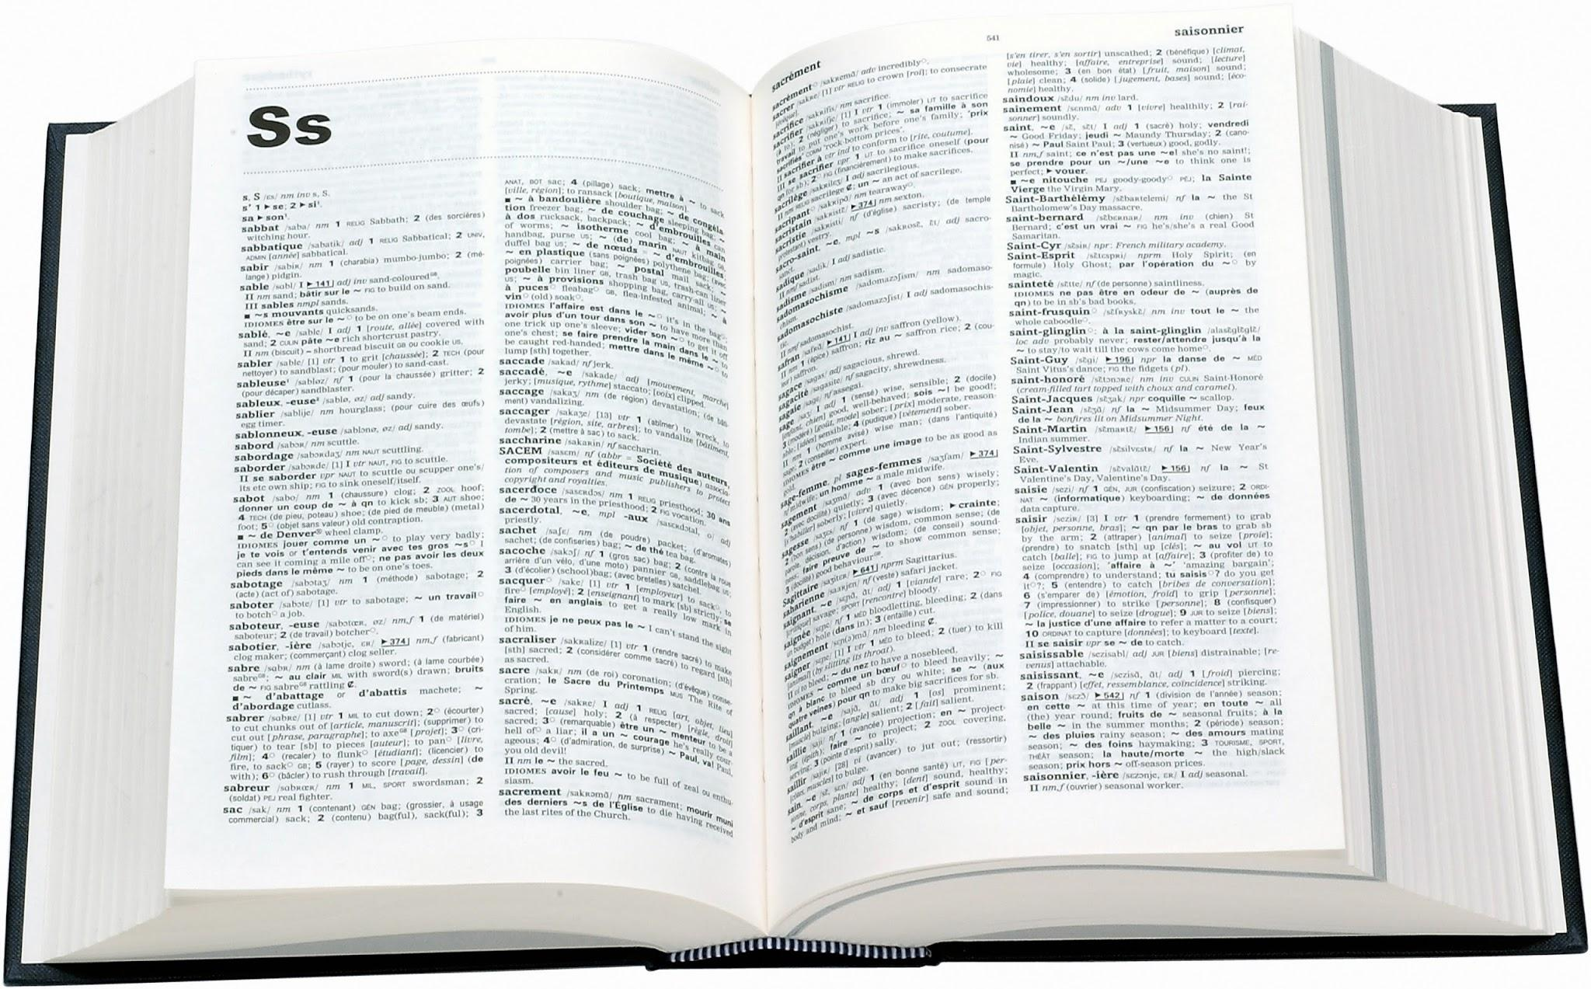
Dictionaries!
You know dictionaries!
They’re great at looking up thing by a word, not a position in a list!
Look up Hello
Get back A greeting (salutation) said when meeting someone or acknowledging someone’s arrival or presence.

Slide 45

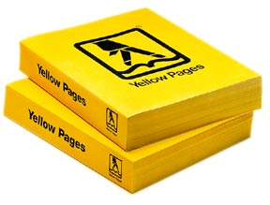
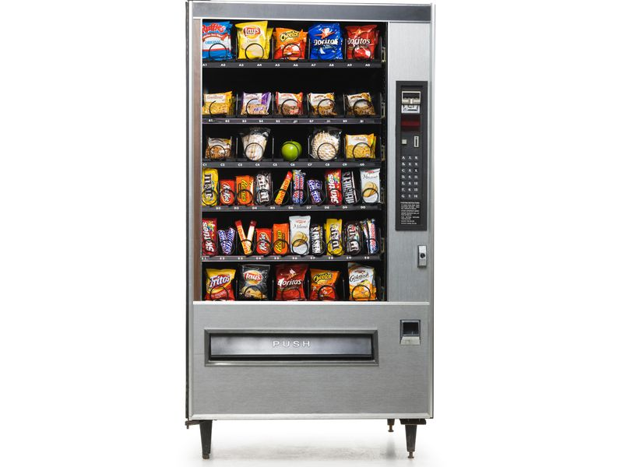
Looking it up!
There are lots of times we want to look something up!
Competition registration
Team Name → List of team members
Phone Book
Vending Machine
Name → Phone number
Treat Name → Price

Slide 46
Looking it up!
Phone Book
Name → Phone number
Key
Value
We can use a dictionary for anything with a key → value pattern!
Notes:
In programmer language
The “look up” part is called a KEY
The “get back” part is called a VALUE

Slide 47
Dictionaries anatomy!
This is a python dictionary!
This dictionary has Alex, Caitlin and Emma’s phone numbers
Stored in the variable phone_book
Made up of pairs of information
Each pair is made up of a key and value
The pairs are separated by commas
phone_book = {"Alex": 111, "Caitlin": 222, "Emma": 333}
Has squiggly brackets
Keys and values are separated by a colon

Slide 48
Playing with dictionaries!
Let’s try using the phone book!
Let’s create the phonebook
>>> phone_book = {
"Alex": 111, "Caitlin": 222, "Emma": 333
}
Let’s get Alex’s number from the phonebook. What will it be?
>>> phone_book["Alex"]

Slide 49
Playing with dictionaries!
Let’s try using the phone book!
Let’s create the phonebook
>>> phone_book = {
"Alex": 111, "Caitlin": 222, "Emma": 333
}
Let’s get Alex’s number from the phonebook. What will it be?
>>> phone_book["Alex"]
111

Slide 50
Updating our dictionaries!
Alex changed her number. Let’s update it!
>>> phone_book["Alex"] = 123
>>> print(phone_book)
We met Rowena! Let’s add her to our phone book
>>> phone_book["Rowena"] = 444
>>> print(phone_book)

Slide 51
Updating our dictionaries!
Alex changed her number. Let’s update it!
>>> phone_book["Alex"] = 123
>>> print(phone_book)
{ "Alex": 123, "Caitlin": 222, "Emma": 333 }
We met Rowena! Let’s add her to our phone book
>>> phone_book["Rowena"] = 444
>>> print(phone_book)

Slide 52
Updating our dictionaries!
Alex changed her number. Let’s update it!
>>> phone_book["Alex"] = 123
>>> print(phone_book)
{ "Alex": 123, "Caitlin": 222, "Emma": 333 }
We met Rowena! Let’s add her to our phone book
>>> phone_book["Rowena"] = 444
>>> print(phone_book)
{ "Alex": 123, "Caitlin": 222, "Emma": 333,
"Rowena": 444 }

Slide 53
Project time!
You now know all about dictionaries!
Let’s put what we learnt into our project
Try to do Part 2
of workbook 2!
The tutors will be around to help!

Slide 54

Python Lists

Slide 55
Lists can store multiple things
A list is an ordered group of related items, all stored in the same variable
>>> day1 = 'Monday'
>>> day2 = 'Tuesday'
>>> day3 = 'Wednesday'
>>> day4 = 'Thursday'
>>> day5 = 'Friday'
>>> day6 = 'Saturday'
>>> day7 = 'Sunday'
>>> days = ['Monday', 'Tuesday', 'Wednesday', 'Thursday', 'Friday', 'Saturday', 'Sunday']

Slide 56

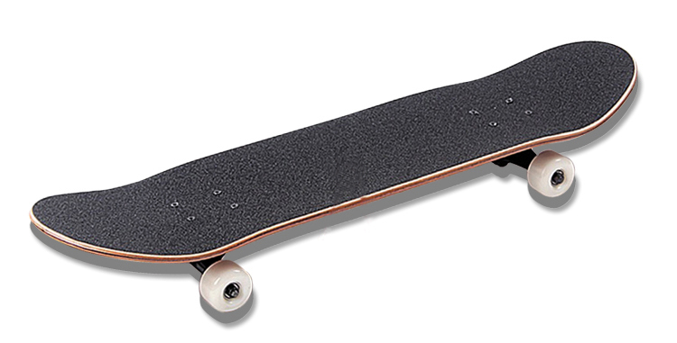

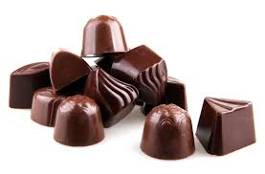
Your Favourite Things!
>>> faves = [‘books', ‘butterfly', ‘chocolate', 'skateboard']
[ , , , ]

Slide 57
Accessing Lists!
The favourites list holds four strings in order.
We can count out the items using index numbers!
0 1 2 3
-4 -3 -2 -1
Indices start from zero!

Slide 58
You can put (almost) anything into a list
You can have a list of integers
>>> primes = [1, 2, 3, 5, 11]
You can have lists with mixed integers and strings
>>> mixture = [1, 'two', 3, 4, 'five']
But this is almost never a good idea! You should be able to treat every element of the list the same way.

Slide 59
Falling off the edge
Python complains if you try to go past the end of a list
>>> faves = ['books', 'butterfly', 'chocolate', 'skateboard']
>>> faves[4]
Traceback (most recent call last):
File "<stdin>", line 1, in <module>
IndexError: list index out of range

Slide 60
Updating items!
We can also update things in a list:
>>> faves = ['books', 'butterfly', 'chocolate', 'skateboard']
>>> faves[1]
'Butterfly'
>>> faves[1] = 'new favourite'
>>> faves[1]
'new favourite'

Slide 61
Removing items!
We can remove items from the list if they’re no longer needed!
What if we decided that we didn’t like butterflies anymore?
>>> faves.remove('butterfly')
What does this list look like now?
[ , , ]

Slide 62
Looping over a list of ints
We can loop through a list:
numbers = [1, 2, 3, 4]
for i in numbers:
print(i)
What’s going to happen?

Slide 63
Looping over a list of ints
We can loop through a list:
Each item of the list takes a turn at being the variable i
Do the body once for each item
We’re done when we run out of items!
numbers = [1, 2, 3, 4]
for i in numbers:
print(i)
What’s going to happen?
>>> 1
>>> 2
>>> 3
>>> 4

Slide 64
How does it work??
Everything in the list gets to have a turn at being the fruit variable
fruits = ['apple', 'banana', 'mango']
for fruit in fruits:
print('yummy ' + fruit)
Let’s set fruit to to the first thing in the list!
fruit is now 'apple'!

Slide 65
How does it work??
Everything in the list gets to have a turn at being the fruit variable
fruits = ['apple', 'banana', 'mango']
for fruit in fruits:
print('yummy ' + fruit)
Let’s set fruit to to the first thing in the list!
fruit is now 'apple'!
print('yummy ' + fruit)
>>> Yummy apple

Slide 66
How does it work??
Everything in the list gets to have a turn at being the fruit variable
fruits = ['apple', 'banana', 'mango']
for fruit in fruits:
print('yummy ' + fruit)
Let’s set fruit to to the first thing in the list!
fruit is now 'apple'!
print('yummy ' + fruit)
We’re at the end of the loop body, back to the top!
>>> Yummy apple

Slide 67
How does it work??
Everything in the list gets to have a turn at being the fruit variable
fruits = ['apple', 'banana', 'mango']
for fruit in fruits:
print('yummy ' + fruit)
Let’s set fruit to to the first thing in the list!
fruit is now 'apple'!
print('yummy ' + fruit)
We’re at the end of the loop body, back to the top!
Let’s set fruit to to the next thing in the list!
fruit is now 'banana'!
>>> Yummy apple

Slide 68
How does it work??
Everything in the list gets to have a turn at being the fruit variable
fruits = ['apple', 'banana', 'mango']
for fruit in fruits:
print('yummy ' + fruit)
Let’s set fruit to to the first thing in the list!
fruit is now 'apple'!
print('yummy ' + fruit)
We’re at the end of the loop body, back to the top!
Let’s set fruit to to the next thing in the list!
fruit is now 'banana'!
print('yummy ' + fruit)
>>> Yummy apple
>>> Yummy banana

Slide 69
How does it work??
Everything in the list gets to have a turn at being the fruit variable
fruits = ['apple', 'banana', 'mango']
for fruit in fruits:
print('yummy ' + fruit)
Let’s set fruit to to the first thing in the list!
fruit is now 'apple'!
print('yummy ' + fruit)
We’re at the end of the loop body, back to the top!
Let’s set fruit to to the next thing in the list!
fruit is now 'banana'!
print('yummy ' + fruit)
Out of body, back to the top!
>>> Yummy apple
>>> Yummy banana

Slide 70
How does it work??
Everything in the list gets to have a turn at being the fruit variable
fruits = ['apple', 'banana', 'mango']
for fruit in fruits:
print('yummy ' + fruit)
Let’s set fruit to to the first thing in the list!
fruit is now 'apple'!
print('yummy ' + fruit)
We’re at the end of the loop body, back to the top!
Let’s set fruit to to the next thing in the list!
fruit is now 'banana'!
print('yummy ' + fruit)
Out of body, back to the top!
Let’s set fruit to to the next thing in the list!
fruit is now 'mango'!
print('yummy ' + fruit)
>>> Yummy apple
>>> Yummy banana
>>> Yummy mango

Slide 71

How does it work??
Everything in the list gets to have a turn at being the fruit variable
fruits = ['apple', 'banana', 'mango']
for fruit in fruits:
print('yummy ' + fruit)
Let’s set fruit to to the first thing in the list!
fruit is now 'apple'!
print('yummy ' + fruit)
We’re at the end of the loop body, back to the top!
Let’s set fruit to to the next thing in the list!
fruit is now 'banana'!
print('yummy ' + fruit)
Out of body, back to the top!
Let’s set fruit to to the next thing in the list!
fruit is now 'mango'!
print('yummy ' + fruit)
>>> Yummy apple
>>> Yummy banana
>>> Yummy mango

Slide 72
Project time!
Lists!
Let’s put what we learnt into our project
Try to do Parts 3 - 4
of workbook 2!
The tutors will be around to help!

